Slide 1
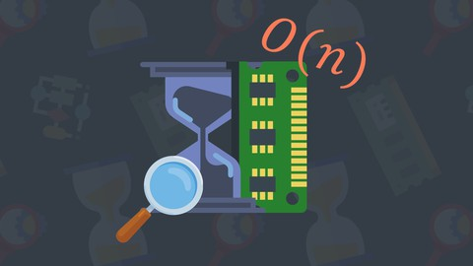

Time Complexity
Programming Club, AKGEC

Slide 2
Measure of “Performance” of an Algorithm
Generally, there is always more than one way to solve a problem in computer science with different algorithms.
Therefore, it is highly required to use a method to compare the solutions in order to judge which one is more optimal. The method must be

Slide 3
1. Worst Case Analysis (Mostly used)
Big ‘O’ notation
In the worst-case analysis, we calculate the upper bound on the running time of an algorithm.
We must know the case that causes a maximum number of operations to be executed.

Slide 4
2. Best Case Analysis (Very Rarely used)
‘Ω’ notation
In the best case analysis, we calculate the lower bound on the running time of an algorithm.
We must know the case that causes a minimum number of operations to be executed

Slide 5
3. Average Case Analysis (Rarely used)
‘Θ’ notation
In average case analysis, we take all possible inputs and calculate the computing time for all of the inputs.
Sum all the calculated values and divide the sum by the total number of inputs. We must know (or predict) the distribution of cases.

Slide 6
Rule of Thumb!
Make it a general rule to consider that a program in a language like C++ can perform 10⁸ operations in 1 second,
while for slower languages like python this number can go as low as around 10⁶ operations in 1 second.

Slide 7
Analysis 1

Slide 8
Analysis 1
Input Size = n
int n;
cin>>n;
for(int i =0; i<n;i++){
for(int j=0;j<n;j++){
cout<<”Hello World! \n”;
}
}
Expected number of operations
= (n*n) + 2
Time Complexity: O(n²)
In,
Best Average and Worst case

Slide 9
Analysis 2
(Linear Search)

Slide 10
Analysis 2
Key = 1 (Best Case)
1 | 5 | 2 | 4 | 3
int a[]= { 1, 5, 2, 4, 3};
int key;
cin>>key;
for(int i =0; i<5;i++){
if( key == a[i] ){
cout<<”found”;
break;
}
}
Key = 3 (Worst Case)
1 | 5 | 2 | 4 | 3
Guess the best and worst case if array size is decided at runtime…

Slide 11
Analysis 3
(Simple Binary Search)

Slide 12
Analysis 3
In binary search, we directly hit the middle element and then compare it with the element to be found. ( Search data needs to be in a sequence )
Search for 9
1 | 2 | 3 | 4 | 5 | 6 | 7 | 8 | 9

Slide 13
Analysis 3
Binary Search
Vs
Linear Search

Slide 14
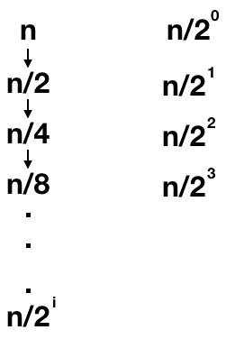
Basically,
we are reducing our problem to half the size in each iteration.

Slide 15
In general, we can write the size of the problem as n/2^{i} after doing i comparisons.
Thus, for the base case,
n/2^{i} = 1
i = log₂n

Slide 16
The comparison will reach the base case only in the worst case and thus, binary search is a O(log(n)) algorithm.

Slide 17
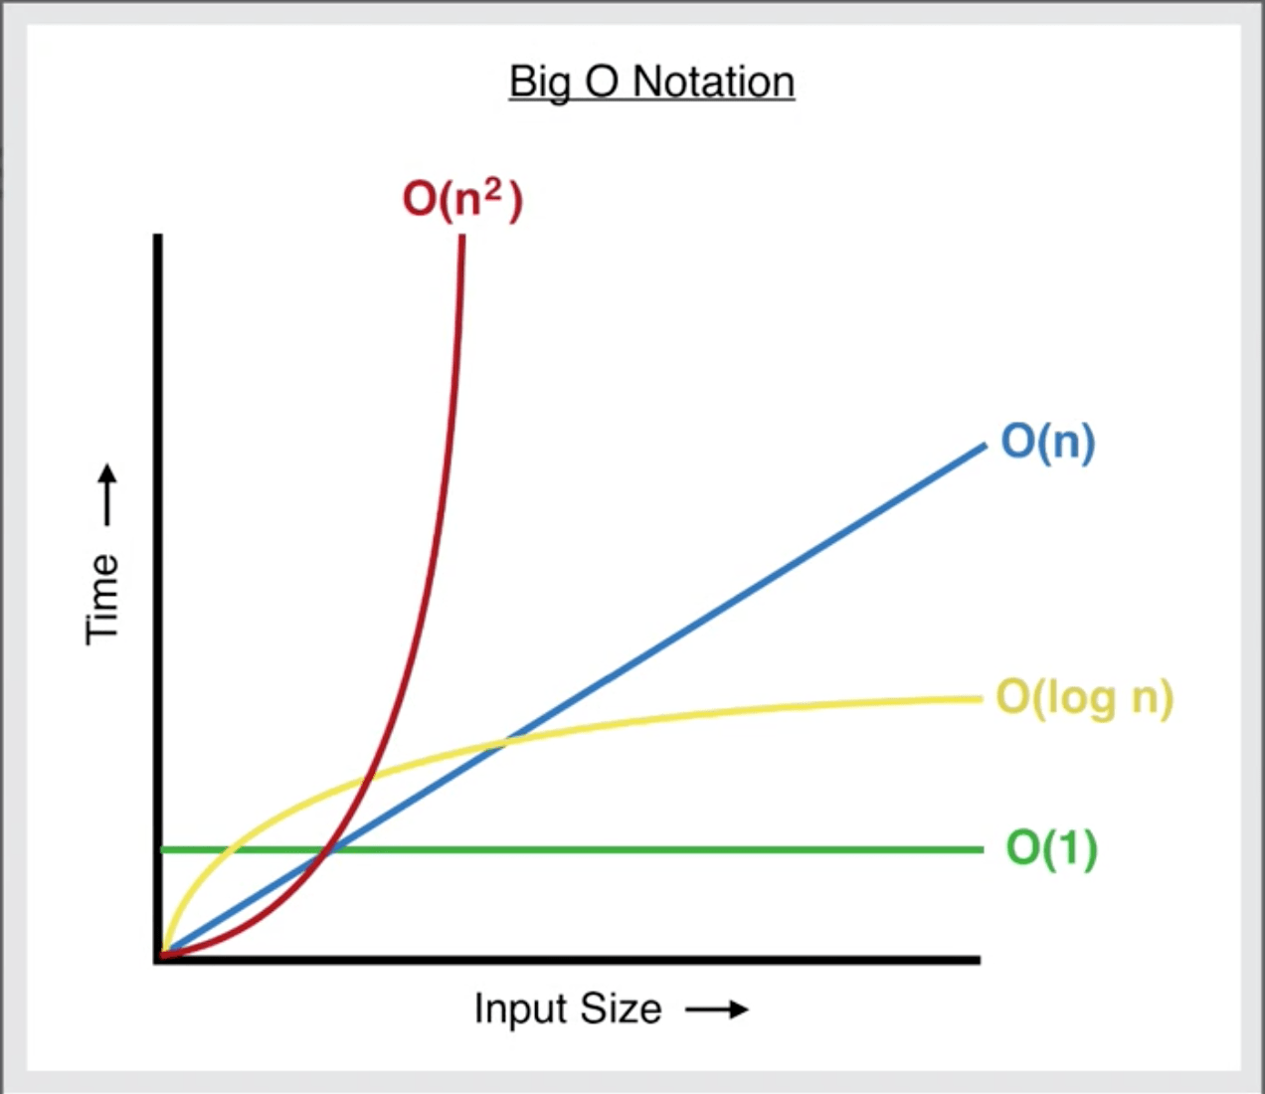
Growth of Functions

Slide 18
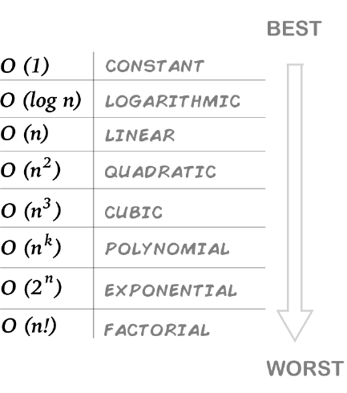

Slide 19
Space Complexity

Slide 20
Space complexity is a parallel concept to time complexity.
If we need to create an array of size n, this will require O(n) space.
If we create a two-dimensional array of size n*n, this will require O(n²) space.
In recursive calls stack space also counts.

Slide 21
int pairSum (int x, int y) {
return x + y;
}
int main() {
int n ;
cin>>n ;
int sum = 0 ;
for( int i =0 ; i<n ; i++ ) {
sum += pairSum( i, i+1 ) ;
}
return 0 ;
}
But Remember :

Slide 22
There will be roughly O(n) calls to pairSum.
However, those calls do not exist simultaneously on the call stack,
so you only need O(1) space.

Slide 23
Happy
Learning
;)

